Slide 1
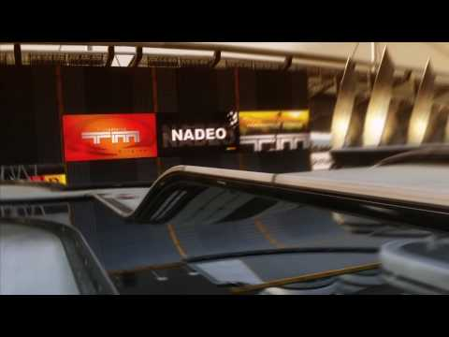
TMCHALLENGER
By:
Kamal Nimmagadda
Mehul Kohli
Ritika Singhal
Rohan Marathe

Slide 2
DEMO: Curve Track

Slide 3
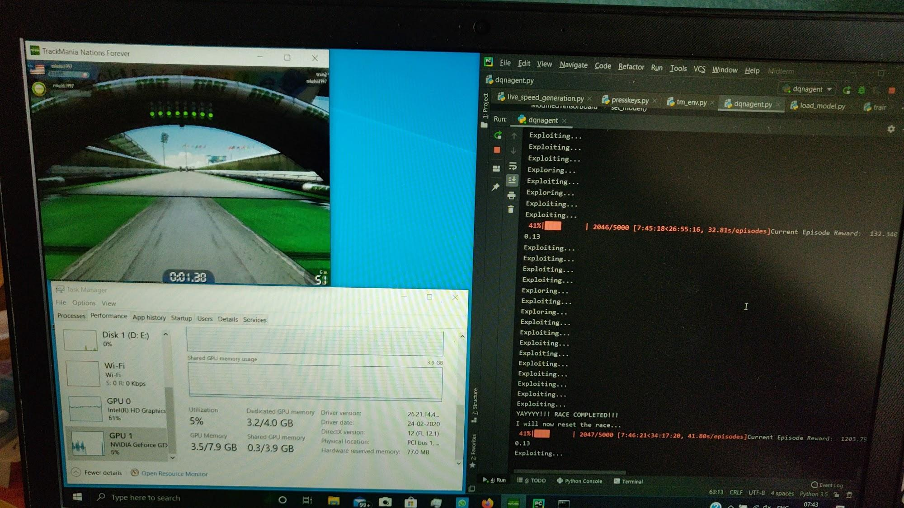

Slide 4
Collision Data Collection

Slide 5
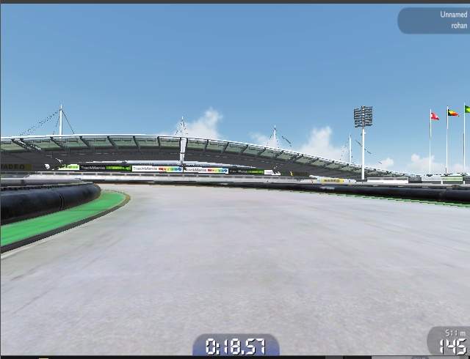
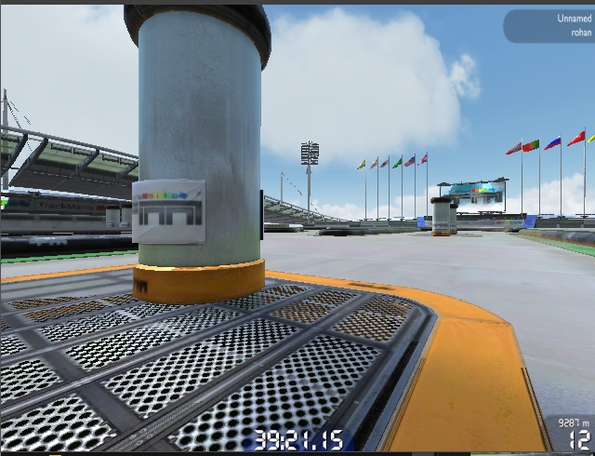
Collision Data
Collected the collision data from any possible collision constraint available in game.
Two collision constraints observed

Slide 6
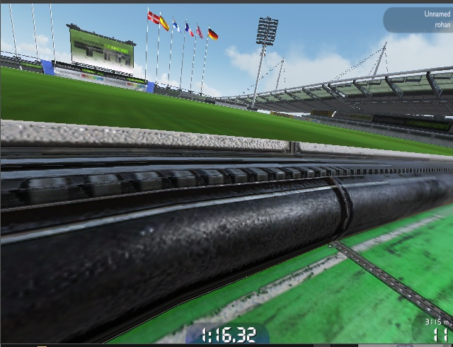
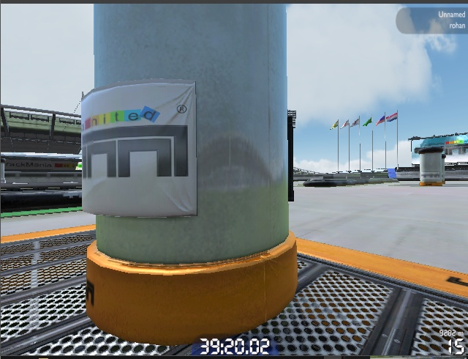
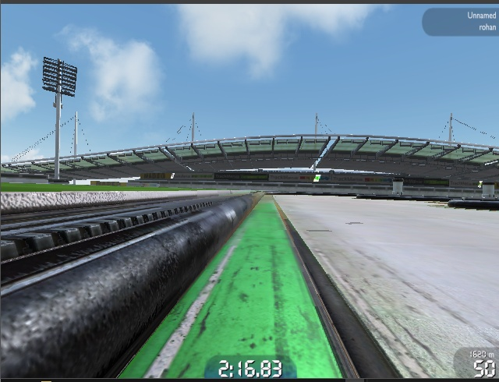
Collision Factors

Slide 7
DEMO: Collision Detection

Slide 8
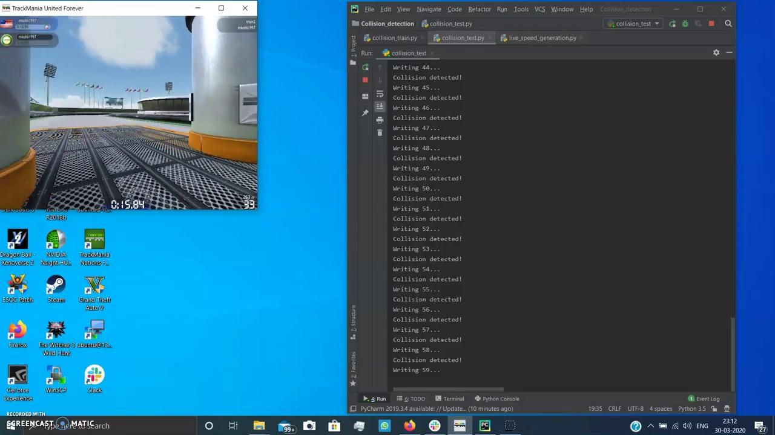

Slide 9
Future Objectives
Integrate collision detection module with our existing DQN model and train it again
Train the DQN on different tracks
Minimize the completion time for each race

